Slide 1
Capstone Project:
Used Car Price Prediction
Affaan Mustafa MIT Applied Data Science Bootcamp 15 April 2022

Slide 2
Why is this an important problem to solve?
The used car market in India is growing rapidly, and there is a huge demand for used cars.
By developing an accurate pricing model for used cars, Cars4U, a tech start-up, can better serve its customers, help sellers set competitive prices, and facilitate transactions in the pre-owned car market.
An effective pricing model will enable the company to devise profitable strategies using differential pricing and gain a competitive edge in the market.

Slide 3
What key questions need to be answered?
What are the most significant factors that influence the price of a used car?
How do these factors interact with each other, and how do they affect the price?
Which machine learning models and techniques are most effective for predicting used car prices?
How can we optimize the performance of the chosen model to increase prediction accuracy?
How can the insights from the pricing model be translated into actionable strategies for Cars4U?

Slide 4
Data Dictionary
S.No. : Serial Number | Name : Name of the car which includes Brand name and Model name
Location : The location in which the car is being sold or is available for purchase (Cities)
Year : Manufacturing year of the car
Kilometers_driven : The total kilometers driven in the car by the previous owner(s) in KM
Fuel_Type : The type of fuel used by the car (Petrol, Diesel, Electric, CNG, LPG)
Transmission : The type of transmission used by the car (Automatic / Manual)
Owner : Type of ownership
Mileage : The standard mileage offered by the car company in kmpl or km/kg
Engine : The displacement volume of the engine in CC
Power : The maximum power of the engine in bhp
Seats : The number of seats in the car
New_Price : The price of a new car of the same model in INR 100,000
Price : The price of the used car in INR 100,000 (Target Variable)

Slide 5
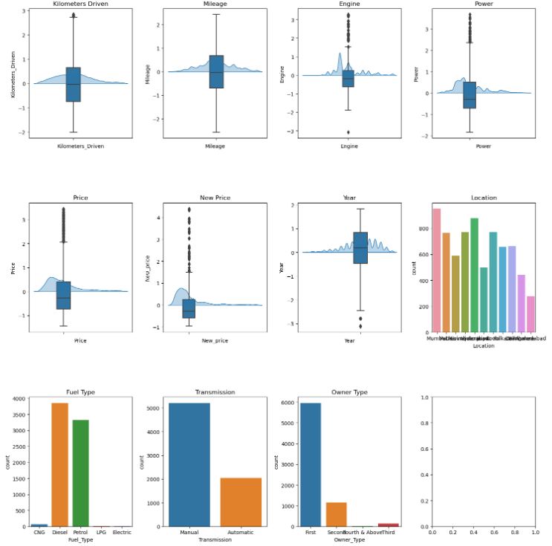
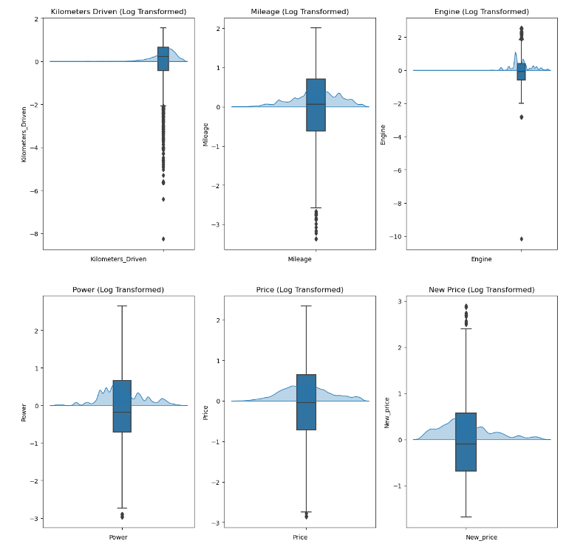
Summary Statistics and Data Distribution
Notes:
Summary Statistics:
The dataset contains 7,253 observations. Some columns have unrealistic values, such as Kilometers_Driven, Mileage, and Engine. A significant amount of data is missing in the New_price column, and some values are missing in the Price column.
Unique Observations in Categorical Columns:
Name: 2,041 unique car models. Location: Cars are located in 11 different cities. Fuel_Type: 5 unique values (diesel, petrol, CNG, LPG, electric). Transmission: 2 unique values (manual, automatic). Owner_Type: 4 unique values (first, second, third, fourth & above).
Outliers and Data Distribution:
Box plots and KDE graphs revealed outliers and non-normal data distribution in variables of interest. The IQR * 1.5 method was applied to remove outliers, as the data was not normally distributed.
Univariate analysis was performed for both numerical and categorical variables using box plots and KDE graphs for numerical variables, and count plots for categorical variables.
Upon examining the box plots and KDE graphs, the distributions of the numerical variables are as follows:
Kilometers_Driven: Right-skewed Mileage: Slightly left-skewed Engine: Slightly right-skewed Power: Right-skewed Price: Right-skewed New_Price: Right-skewed Year: Slightly left-skewed Given the presence of skewness in the numerical variables, log transformation should be applied to reduce the skewness and improve the distribution of the data. Log transformation should be applied to the following variables: Kilometers_Driven, Mileage, Engine, Power, Price, New_Price, and Year.
After applying the log transformation to the skewed numerical variables and re-scaling the data, the distributions of the log-transformed variables appeared more symmetric and less skewed, as evident in the updated box plots and KDE graphs shown below.

Slide 6
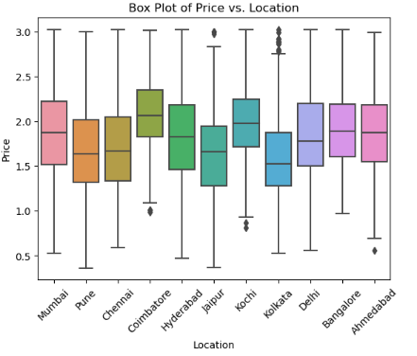
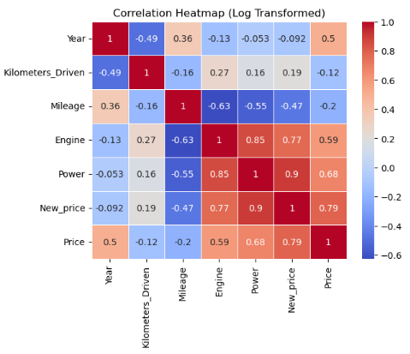
Bivariate Analysis and Preprocessing
Further Feature Engineering and Data Preprocessing:
Drop Name Column and Replace With Brand
Apply Missing Value Treatment for Price, New Price, Power, Engine Mileage
Use KNN Imputation
Use Median Imputation
Compare
Why IQR +- 1.5 for Outliers and not 3 Standard Deviations?
Notes:
Analyzing the correlation heatmap, we can observe the relationships between the dependent variable (Price) and each independent variable.
The most notable correlations are: New_Price: Positive correlation of 0.79, indicating that as the new price of a car increases, the used car price also tends to increase. Power: Positive correlation of 0.68, suggesting that as the power of a car increases, its price also tends to increase. Year: Positive correlation of 0.5, meaning that newer cars generally have higher prices compared to older cars. Engine: Positive correlation of 0.59, indicating that cars with larger engine capacities tend to have higher prices. Kilometers_Driven: Negative correlation of 0.12, showing that as the number of kilometers driven increases, the car price tends to decrease. Although this correlation is relatively weak, it could be significant due to the cumulative effect of large variations in the kilometers driven.
Observations from the box plot of Price vs. Location:
Kolkata has many high outliers, suggesting that some used cars in Kolkata are priced significantly higher than the majority. Coimbatore has a median price above all other locations, implying that used cars in Coimbatore tend to be more expensive. However, further statistical tests, such as t-tests, are required to determine if the difference is statistically significant. Jaipur also has a few high outliers, indicating some used cars in Jaipur have exceptionally high prices. Coimbatore, Kochi, and Ahmedabad have a few low outliers, suggesting that some used cars in these locations are priced lower than the majority.

Slide 7
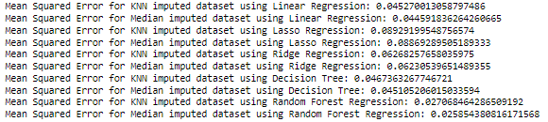
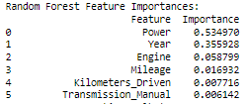
Model Comparison and Performance
Imputation Methods Compared:
K - Nearest Neighbor
Median Imputation
Algorithms Tested:
1) Linear Regression
2) Ridge / Lasso Regression
3) Decision Trees
4) Random Forest
Metric of Success:
Lowest Mean Squared Error
Training/Test Split of 75/25
Notes:
Given the above comparisons of different models within regression the best performing models seem to be Simple Log Transformed Linear Regression and Random Forest Regression ; the other models have higher runtime complexity and similar or worse performace using Mean Squared Error as our performance metric; therefore after comparing and contrasting the ideal method if we want to focus purely on efficiencty would be a simple log transformed linear regression model and if we want more accurate results a random forest regression method performs best.

Slide 8
Key Findings and Insights
Evaluation:
Median imputation with Random Forest Regression technique has the lowest MSE of 0.0258 on the median imputed dataset.
The performance of the imputation techniques (KNN vs. Median) seems to have a small effect on the MSE.
Random Forest Regression generally outperforms other regression techniques (Linear, Lasso, Ridge, Decision Tree) on both KNN and Median imputed datasets.
Tradeoff between Computational Exhaustion and Lowering the MSE
Further Improvements:
Trying other imputation techniques such as missForest, MICE, or Bayesian imputation.
Trying other regression techniques such as Gradient Boosting or Neural Networks.
Conducting further feature engineering to select relevant features and reduce noise in the dataset.
Increasing the size of the dataset if possible.
Combining multiple models using ensembling techniques such as Bagging or Boosting to improve prediction accuracy.
Notes:
Median imputation with Random Forest Regression technique has the lowest MSE of 0.0258 on the median imputed dataset. The performance of the imputation techniques (KNN vs. Median) seems to have a small effect on the MSE. Random Forest Regression generally outperforms other regression techniques (Linear, Lasso, Ridge, Decision Tree) on both KNN and Median imputed datasets. To improve the performance further, some possible approaches could be:
Trying other imputation techniques such as missForest, MICE, or Bayesian imputation. Trying other regression techniques such as Gradient Boosting or Neural Networks. Conducting further feature engineering to select relevant features and reduce noise in the dataset. Increasing the size of the dataset if possible. Combining multiple models using ensembling techniques such as Bagging or Boosting to improve prediction accuracy.
There is a tradeoff between computational exhaustion and lowering the MSE, however to best fit the model without overfitting the model using median imputation to fill in the empty data and performing random forest regression results in the lowest Mean Squared Error, indicating it to be our best model according to our cross validation results. This can give us a relatively good model to predict used car prices. The most notable features in our chosen model of Random Forest Regression is consistent with other models we tried as well and that has to do with Year, Power and Engine. After that KM Driven and Mileage have some effect. Location and other features does not play as large of a role as expected while still useful to have the less parameters we have while still maintaining accuracy the more consistent we are.
There is a tradeoff between computational exhaustion and lowering the MSE, however to best fit the model without overfitting the model using median imputation to fill in the empty data and performing random forest regression results in the lowest Mean Squared Error, indicating it to be our best model according to our cross validation results. This can give us a relatively good model to predict used car prices. The most notable features in our chosen model of Random Forest Regression is consistent with other models we tried as well and that has to do with Year, Power and Engine. After that KM Driven and Mileage have some effect. Location and other features does not play as large of a role as expected while still useful to have the less parameters we have while still maintaining accuracy the more consistent we are.

Slide 9
Business Recommendations and Next Steps
The key actionable for stakeholders include:
Using the proposed solution to develop pricing strategies that optimize profit and customer satisfaction.
Supporting sellers in setting appropriate prices for their used cars. Helping buyers make well-informed purchasing decisions in the used car market.
The expected benefits of implementing the proposed solution are accurate predictions Used Car Prices, which can help Cars4U in making informed decisions related to buying and selling used cars.
The costs associated with implementing the solution include the time and resources required for feature engineering, ensembling, and further analysis. This includes compute complexity and if possible the cloud credits needed to run models like this. This balance between model accuracy and overhead costs will need to be optimized.
The key risks and challenges include the potential for overfitting the model, which can lead to inaccurate predictions and poor decision-making. Additionally, the accuracy of the model may be affected by factors such as changes in the used car market or the availability of new data.
Notes:
Based on the analysis and evaluation of different imputation and regression techniques, the proposed final solution design is to use median imputation with Random Forest Regression for predicting the missing values in the Price column.
Recommendations for Implementation:
Some key recommendations to implement the proposed solution include:
Implementing median imputation with Random Forest Regression for predicting the missing values in the Price column. This will help normalize the data.
Employing feature engineering techniques to select relevant features and reduce noise in the dataset. This will lead to a more accurate model.
Using ensembling techniques such as Bagging or Boosting to combine multiple models and improve prediction accuracy. This will lead to more consistent results and a more accurate model.
Conducting further feature engineering to select relevant features and reduce noise in the dataset. Further hyperparameter tuning might be neccesary to find the most optimal features to provide us with the most suitable model.
Increasing the size of the dataset if possible. This includes getting actual values if possible for any missing values.
Conducting further statistical tests, such as t-tests, to determine the statistically significant differences in used car prices among different locations. This will help in determining categorical differences and how that could effect prices in different settings.
The key actionable for stakeholders include:
Using the proposed solution to develop pricing strategies that optimize profit and customer satisfaction.
Supporting sellers in setting appropriate prices for their used cars. Helping buyers make well-informed purchasing decisions in the used car market.
The expected benefits of implementing the proposed solution are accurate predictions for the missing values in the Price column, which can help Cars4U in making informed decisions related to buying and selling used cars.
The costs associated with implementing the solution include the time and resources required for feature engineering, ensembling, and further analysis. This includes compute complexity and if possible the cloud credits needed to run models like this. This balance between model accuracy and overhead costs will need to be optimized.
The key risks and challenges include the potential for overfitting the model, which can lead to inaccurate predictions and poor decision-making. Additionally, the accuracy of the model may be affected by factors such as changes in the used car market or the availability of new data.
This approach has the lowest MSE among the evaluated techniques and performs consistently well on both KNN and median imputed datasets. Additionally, Random Forest Regression is a powerful technique that can handle non-linear relationships between variables and can capture complex interactions between features.
To further improve the performance of the model, feature engineering techniques can be employed to select relevant features and reduce noise in the dataset. Additionally, ensembling techniques such as Bagging or Boosting can be used to combine multiple models and improve prediction accuracy.
Overall, the proposed solution design using median imputation with Random Forest Regression, along with feature engineering and ensembling techniques, can provide accurate predictions for the missing values in the Price column and help in making informed decisions related to buying and selling used cars.

Slide 10
Conclusion
The used car market in India is growing rapidly, and an accurate pricing model is essential to help customers, sellers, and the tech start-up Cars4U make informed decisions in the pre-owned car market.
Through the development of a predictive pricing model using median imputation with Random Forest Regression, we were able to accurately estimate the price of used cars based on various factors such as mileage, brand, model, year, location, and more.
Our analysis revealed the most significant factors that influence the price of a used car, such as new price, power, year, engine, and kilometers driven.
Our proposed solution design using median imputation with Random Forest Regression, along with feature engineering and ensembling techniques, can provide accurate predictions for the missing values in the Price column and help in making informed decisions related to buying and selling used cars.
To further improve the performance of the model, some possible approaches could be trying other imputation and regression techniques, conducting further feature engineering, and increasing the size of the dataset if possible.
The proposed solution can give Cars4U a competitive edge in the market and help in developing profitable strategies using differential pricing.
Notes:
In conclusion, our project aimed to develop an accurate pricing model for used cars in India to help customers, sellers, and the tech start-up Cars4U make informed decisions in the pre-owned car market. We were able to achieve this through the development of a predictive pricing model using median imputation with Random Forest Regression. Our analysis revealed the most significant factors that influence the price of a used car, such as new price, power, year, engine, and kilometers driven. Our proposed solution design can provide accurate predictions for the missing values in the Price column and help in making informed decisions related to buying and selling used cars. To further improve the performance of the model, some possible approaches could be trying other imputation and regression techniques, conducting further feature engineering, and increasing the size of the dataset if possible. Overall, the proposed solution can give Cars4U a competitive edge in the market and help in developing profitable strategies using differential pricing.

Slide 11
Thank you for your time and attention 🙂

